Slide 1


SOFTWARE ENGINEERING (Week-5)
Usama Musharaf
MS-CS (Software Engineering)
Lecturer (Department of Computer Science)
FAST-NUCES Peshawar

Slide 2
Agenda of week # 5
Software Design & Architecture
Design Principles
Design Concepts
Effective Modular Design
Types of Coupling & Cohesion

Slide 3


Slide 4
The Software Design Process

Slide 5
Design Process Activities
Architectural design
Modules, inter-relationships etc
Abstract specification
Services of each sub-system, constraints etc
Interface design
Interface to other sub-system or outside environment
Component design
Services allocated to components and their interfaces designed
Data structure design
Algorithm design

Slide 6
Levels of Software Design
Architectural design (high-level design)
architecture - the overall structure, main modules and their connections
addresses the main non-functional requirements (e.g., reliability, performance)
hard to change
Detailed design (low-level design)
the inner structure of the main modules
detailed enough to be implemented in the programming language

Slide 7
Architecture
Design
Implementation

Slide 8
Design vs. Architecture
Architecture is concerned with the selection of architectural elements, their interaction, and the constraints on those elements and their interactions
Design is concerned with the modularization and detailed interfaces of the design elements, their algorithms and procedures, and the data types needed to support the architecture and to satisfy the requirements.
Architecture…is specifically not about…details of implementations (e.g., algorithms and data structures.)

Slide 9
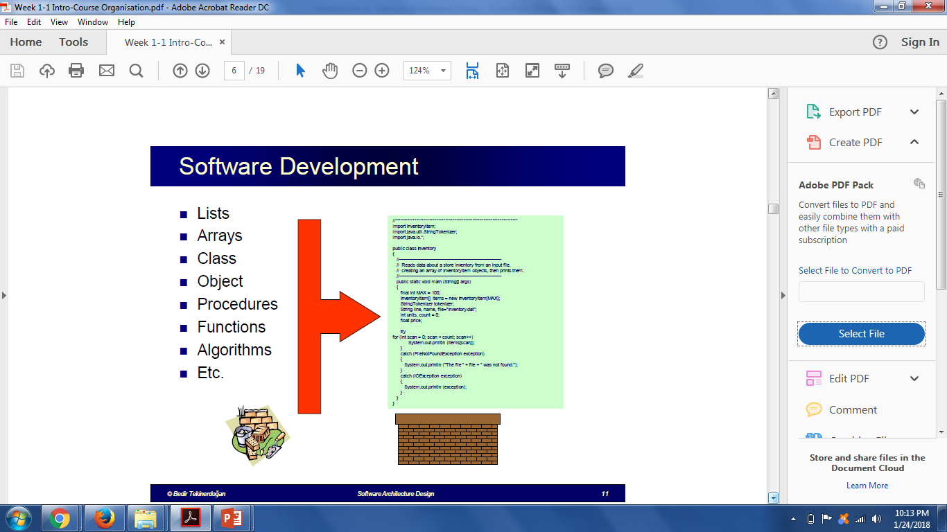

Slide 10
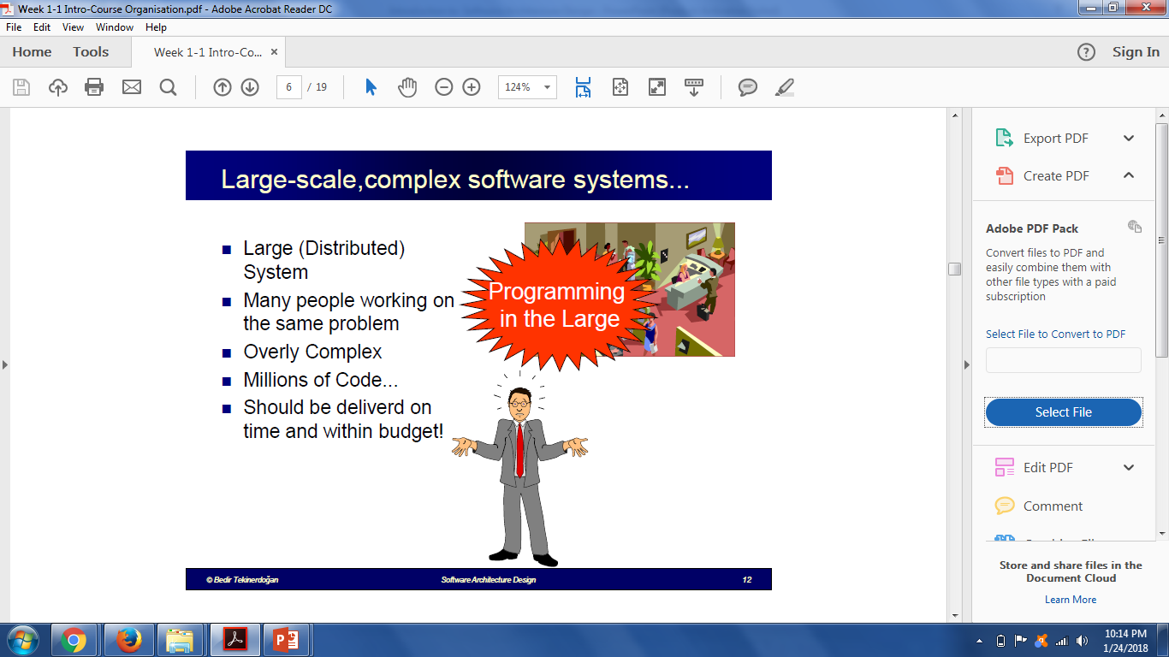

Slide 11
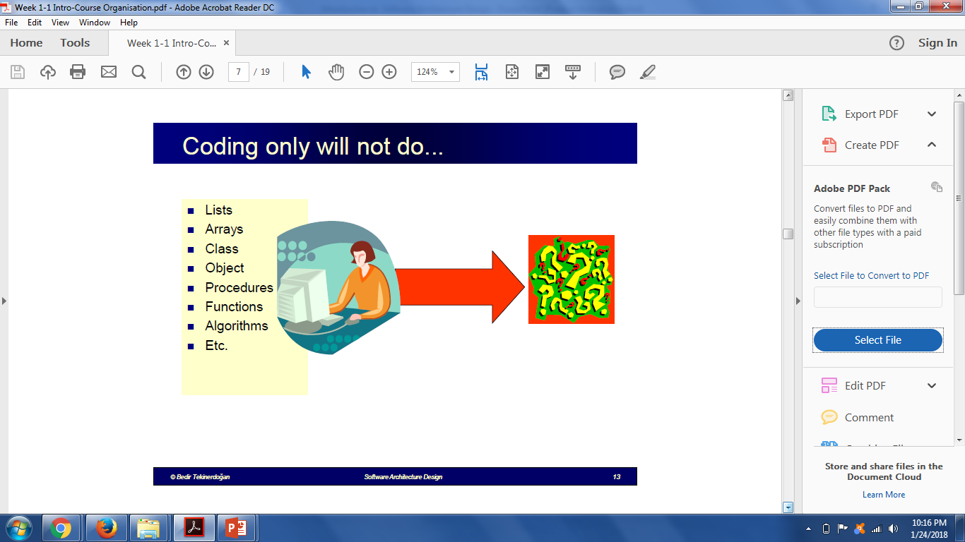

Slide 12
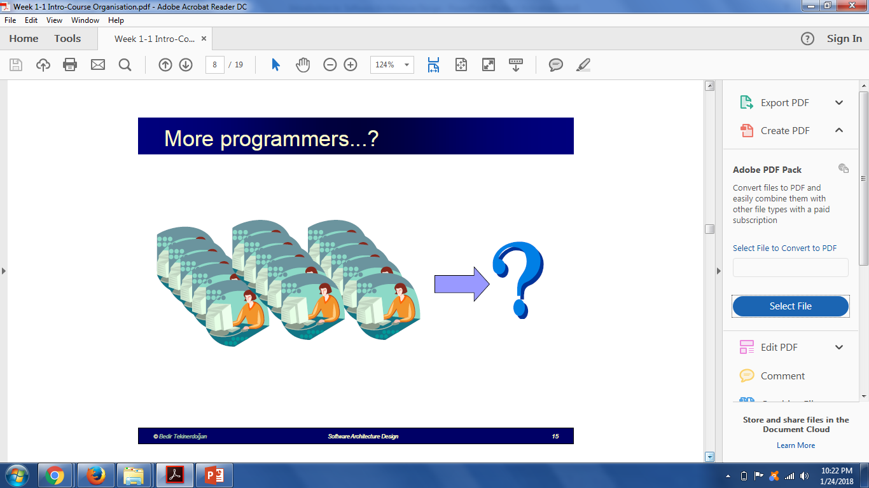

Slide 13
Software Architecture
The software architecture of a program or computing system is the structure or structures of the system, which comprise software components, the externally visible properties of those components, and the relationships between them.

Slide 14
Design principles

Slide 15
Design Principles
1- The design process should not suffer from “tunnel vision.”
A good designer should consider alternative approaches, judging each based on the requirements of the problem, the resources available to do the job, and the design concepts.
2- The design should be traceable to the analysis model.

Slide 16
Design Principles
3- The design should not reinvent the wheel.
Systems are constructed using a set of design patterns.
These patterns should always be chosen as an alternative to reinvention.
Time is short and resources are limited!

Slide 17
Design Principles
4- The design should “minimize the intellectual distance” between the software and the problem as it exists in the real world.
5- The design should exhibit uniformity and integration

Slide 18
Design Principles
6- The design should be structured to accommodate change
7- The design should be assessed for quality as it is being created

Slide 19
Design Concepts

Slide 20
Fundamental Concepts of Design
abstraction—data, procedure, control
refinement—elaboration of detail for all abstractions
modularity—compartmentalization of data and function
architecture—overall structure of the software
Styles and patterns
procedure—the algorithms that achieve function
hiding—controlled interfaces

Slide 21
Abstraction
“Capture only those details about an object that are relevant to current perspective”
Suppose we want to implement abstraction for the following statement,
“Ali is a PhD student and teaches BS students”
Here object Ali has two perspectives one is his student perspective and second is his teacher perspective.

Slide 22
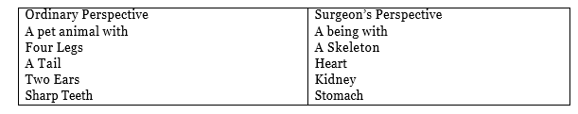
Abstraction
A cat can be viewed with different perspectives.

Slide 23
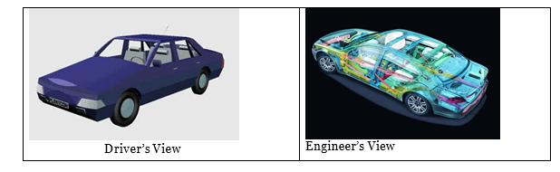
Abstraction
A car can be viewed with different perspectives.

Slide 24
Abstraction Advantages
It helps us understanding and solving a problem using object oriented approach as it hides extra irrelevant details of objects.
Focusing on single perspective of an object provides us freedom to change implementation for other aspects of for an object later.
Abstraction is used for achieving information hiding as we show only relevant details to related objects, and hide other details.

Slide 25
Data Abstraction
door
manufacturer
model number
type
swing direction
inserts
lights
type
number
weight
opening mechanism
implemented as a data structure

Slide 26
Procedural Abstraction
open
details of enter
algorithm
implemented with a "knowledge" of the
object that is associated with enter

Slide 27
Stepwise Refinement
open
walk to door;
reach for knob;
open door;
repeat until door opens
turn knob clockwise;
walk through;
if knob doesn't turn, then
close door.
take key out;
find correct key;
insert in lock;
endif
pull/push door
move out of way;
end repeat

Slide 28
Modular Design
Easier to manage
Easier to understand
Reduces complexity
Delegation / division of work
Fault isolation
Independent development
Separation of concerns
Reuse

Slide 29
Modularity: Trade-offs
What is the "right" number of modules
for a specific software design?
module development cost
cost of
software
module
integration
cost
optimal number
number of modules
of modules

Slide 30
Information Hiding
module
• algorithm
controlled
interface
• data structure
• details of external interface
• resource allocation policy
clients
"secret"
a specific design decision

Slide 31
Information Hiding
Design the modules in such a way that information (data & procedures) contained in one module is inaccessible to other modules that have no need for such information.
Independent modules.
Benefits:
when modifications are required, it reduces the chances of propagating to other modules.

Slide 32
EFFECTIVE MODULAR DESIGN

Slide 33
Functional Independence

Slide 34
Coupling
Coupling is a measure of independence of a module or component.
Loose coupling means that different system components have loose or less reliance upon each other.
Hence, changes in one component would have a limited affect on other components.

Slide 35
Coupling
High coupling causes problems
Change propagation- ripple effect
Difficulty in understanding
Difficult reuse

Slide 36
Cohesion
Cohesion is a measure of the degree to which the elements of the module are functionally related.
It is the degree to which all elements directed towards performing a single task are contained in the component.
Basically, cohesion is the internal glue that keeps the module together.
A good software design will have high cohesion

Slide 37
Coupling & Cohesion
A Software should be Lesly coupled and highly cohesive.
37

Slide 38
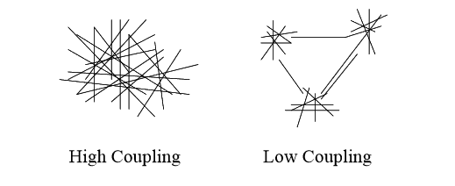
Coupling
38

Slide 39
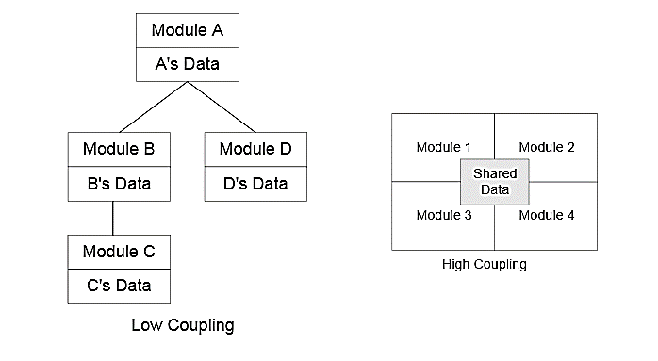
Coupling

Slide 40
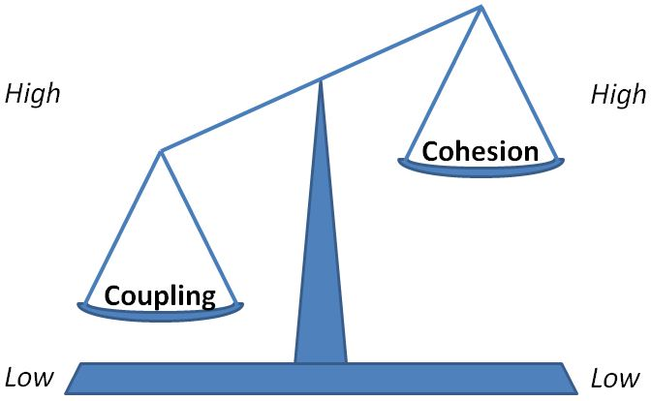
Relationship between Coupling and Cohesion

Slide 41
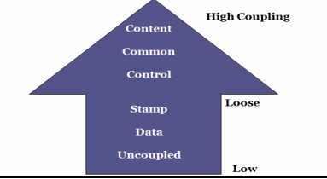
Types of Coupling

Slide 42
Content Coupling
This is highest level of coupling and occurs if there are two (or more) modules and if one refers to the ``inside'' - the ``internal'' or ``private'' part - of the other in some way.
Component A handles lookup data.
Component is handling the property of adding new customer when needed.
Component-A
Component-B

Slide 43
Content Coupling Example
When we are searching the customer data and customer is not found, lookup component adds customer by directly modifying the contents of the data structure containing customer data (new customer).
This is a very high level of coupling in which one component is directly modifying the content of another component and this is not wanted in any software design.
Component-A
Component-B

Slide 44
Content Coupling Example
Solution:
When customer not found, component calls the AddCustomer () method that is responsible for maintaining customer data rather than directly modifying data structure.

Slide 45
Common Coupling
Common coupling occurs when modules communicate using global data structures.
For example, programming allows the developer to declare a data element as external, enabling it to be accessed by all modules.
Common coupling is also known as “Global coupling”. We can say that two components share data using Global data structures.

Slide 46
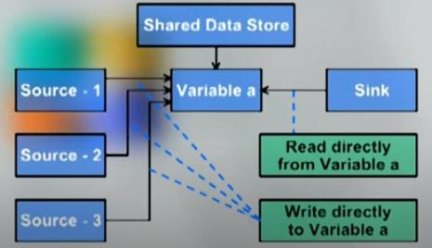
Common Coupling Example

Slide 47
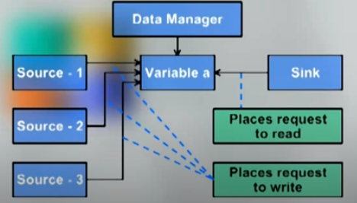
Common Coupling
Solution:

Slide 48
HAVE A GOO DAY!

